Slide 1
What is the Microsoft Cloud Adoption Framework?

Slide 2
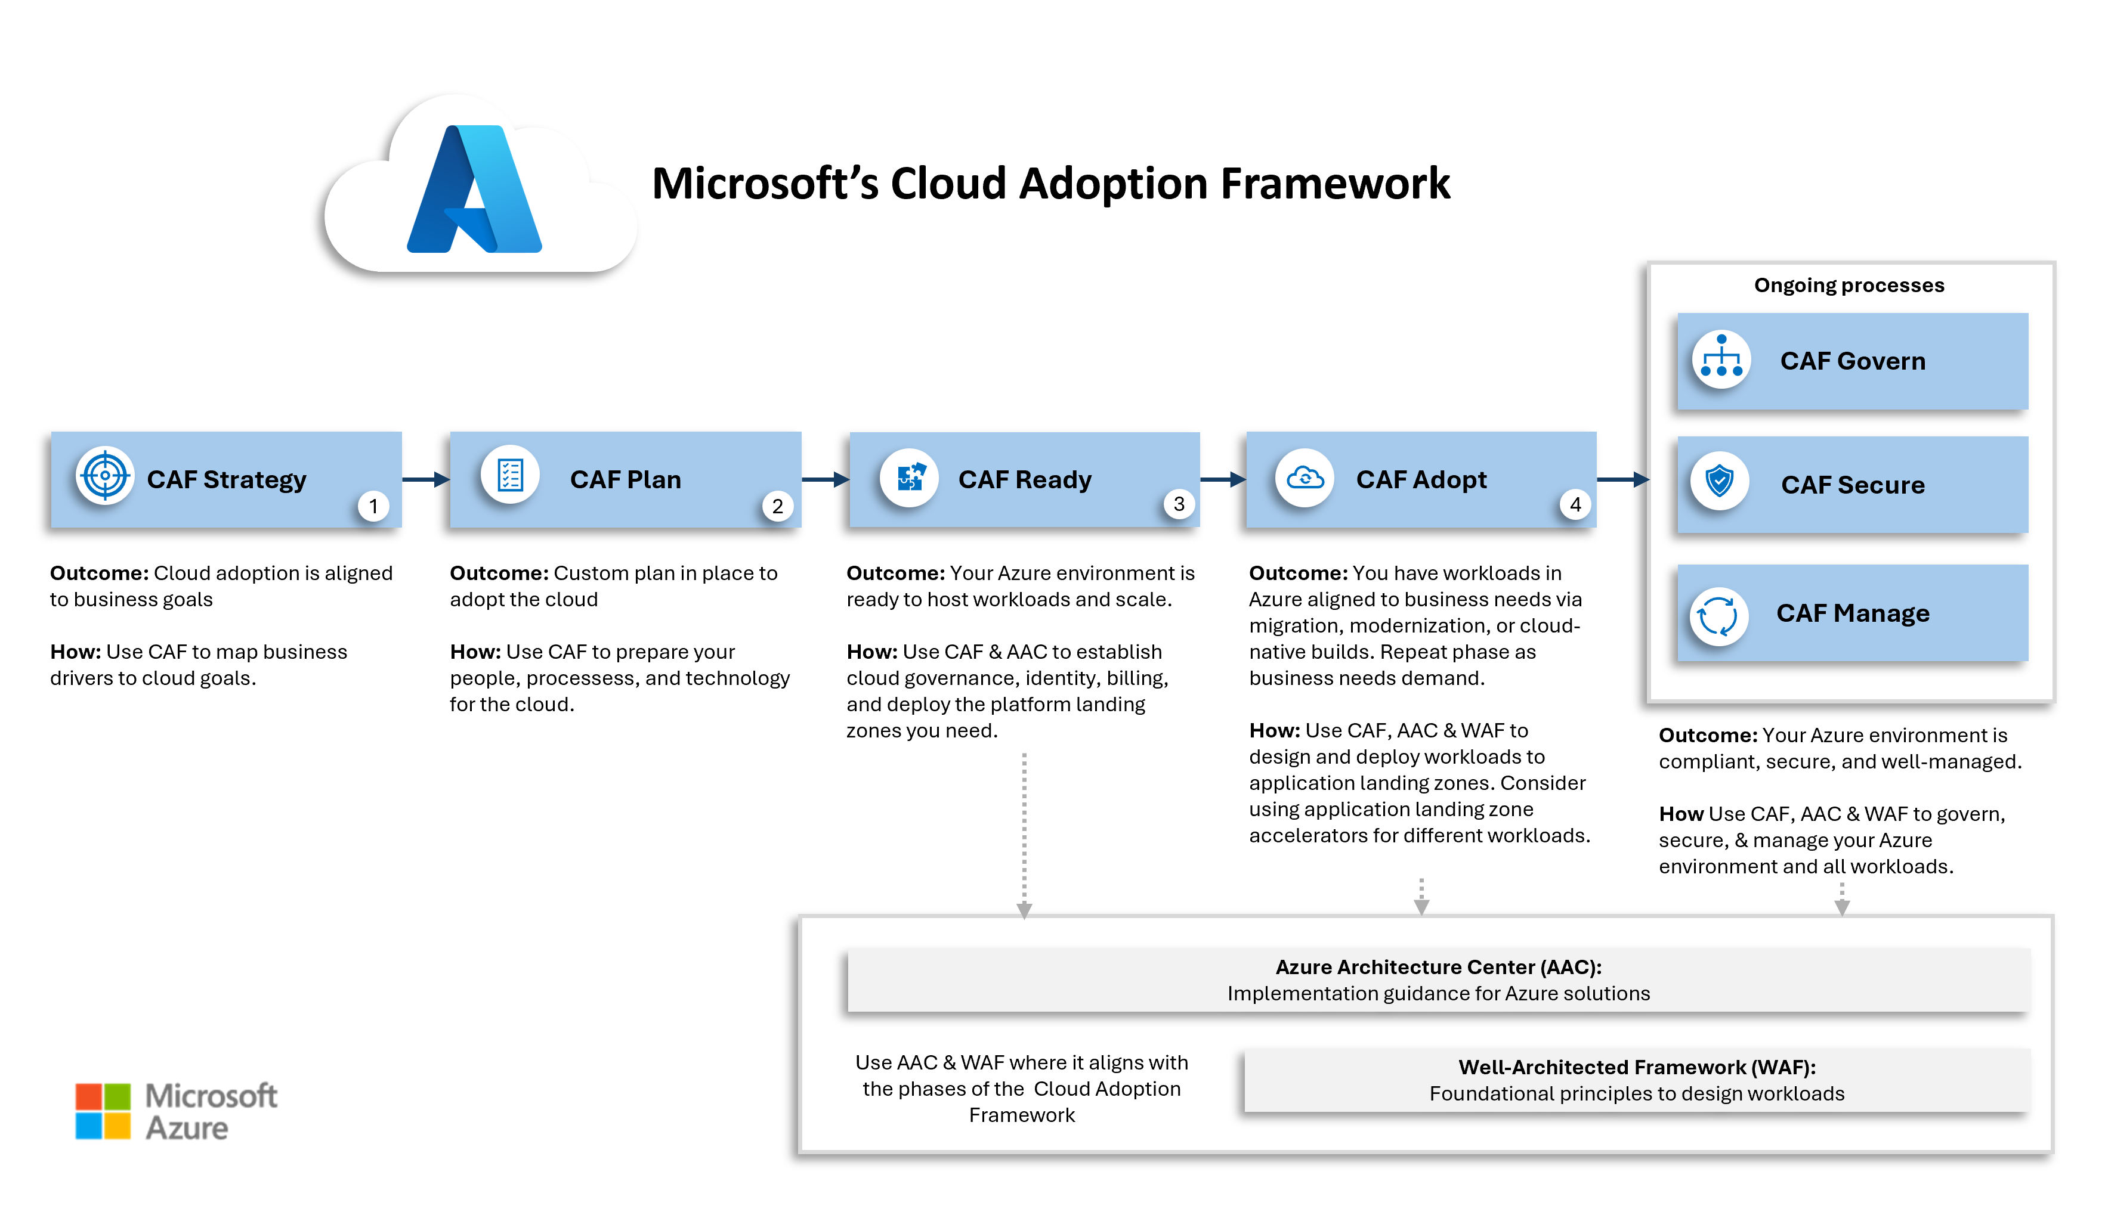
What is the Microsoft Cloud Adoption Framework?
The Microsoft Cloud Adoption Framework (CAF) is a structured roadmap that helps organizations successfully adopt Azure and integrate it into their existing IT environments. It provides best practices and guidance to help organizations make the right decisions for their business throughout the cloud journey.

Slide 3
How does the Cloud Adoption Framework work?
CAF methodology (phases) | Outcome | How
🚀 1. Strategy | Cloud adoption aligned to business goals | Map business drivers to cloud outcomes.
📝 2. Plan | A plan for cloud adoption | Operating model, cloud skills, migration plan, and cloud cost estimation.
🛠️ 3. Ready | An Azure environment ready for workloads | Azure purchasing, tenant setup, platform landing zone, application landing zones.
🌐 4. Adopt | Workloads in Azure meeting business needs | Migrate, modernize, or build-cloud native workloads.
🛡️ 5. Govern | Control workloads | Assess cloud risks and mitigate with Azure and Microsoft tools.
🔒 6. Secure | Protect workloads | Apply security control with with Azure and Microsoft tools.
⚙️ 7. Manage | Optimize workloads | Administer workloads with Azure and Microsoft tools.
The Cloud Adoption Framework organizes Azure guidance into seven core methodologies that together guide an organization’s cloud journey.
The foundational methodologies (Strategy, Plan, Ready, and Adopt) are sequential. They help you define business outcomes, prepare your organization and environment, and deploy workloads to Azure.
Once workloads are running in Azure, the operational methodologies (Govern, Secure, and Manage) define different aspects of your cloud operations that help ensure your Azure environment remains compliant, protected, and optimized over time.

Slide 4
Why use the Cloud Adoption Framework?
The Cloud Adoption Framework is about adopting cloud technologies and integrating them into your business. It provides proven practices to govern, secure, and manage all workloads.
It provides structured processes for migrating, modernizing, and building cloud‑native solutions.
Throughout each stage of adoption, the framework guides you to the right tools, architectures, and other resources to help you achieve your organizational goals.
Who is the Cloud Adoption Framework for?
The Microsoft Cloud Adoption Framework serves organizations across all industries and scales pursuing strategic Azure cloud adoption.
This framework adapts to your specific cloud maturity level, from initial Azure evaluation through advanced multicloud optimization strategies, It's designed for anyone in the organization responsible for technology adoption, whether that responsibility spans business strategy, technology governance, cloud integration, or day‑to‑day operations.

Slide 5
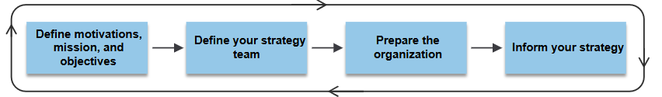
CAF methodology (phases) | Outcome | How
🚀 1. Strategy | Cloud adoption aligned to business goals | Map business drivers to cloud outcomes.
Develop a cloud adoption strategy → A sound strategy starts with a clear understanding of your business objectives. From there, it defines the priorities, guardrails, and investment decisions that align cloud initiatives to those objectives.
Strategy isn't a one-time exercise. Organizations mature through iteration, so treat this guidance as a recurring input to your strategy rather than a one-pass document. Revisit it as business conditions, regulatory requirements, and your cloud footprint evolve.
How to build a cloud adoption strategy
Define motivations, mission, and objectives. Establish the business reasons for adopting cloud and the outcomes by which success is measured.
Define your strategy team. Identify the leaders and stakeholders accountable for setting direction and ensuring execution across the organization.
Prepare the organization. Secure executive sponsorship, align organizational strategies, evaluate your operating model's fit for cloud, and decide whether to shift toward a product-oriented model.
Inform your strategy. Apply strategic considerations across the dimensions that shape cloud outcomes: cost efficiency, resiliency, security, and sustainability.

Slide 6
Azure CAF – Strategy (Deep Dive)
Strategy phase mein company ye decide karti hai ki Azure mein jaana hi kyun hai. WHY Azure ???
"The Strategy phase focuses on defining the business justification, expected outcomes, stakeholders, and financial goals for cloud adoption."
Suppose in a company there is 300 physical server h , 20 Network devices, 50 tb storage, 10 Applications, 100 IT employes h. Sab ki costing h 8CR annually. What management thinks ?? Can we reduce cost by migrating to cloud ??
Example :
Own data center → Azure (Pay as you go).
Faster Deployment → earlier server purchase, Delivery, installation, configuration.. On Azure create VM in 5 minutes
Traffic suddenly increased ?? On Prem its hard to deploy within minutes. In Azure Autoscaling.
Disaster recovery → On prem only one.. In Azure multiple regions.
Innovation → Business need AI , ML, Chat Bots.. Azure provide all readymade services.
Stakeholders in Strategy Phase ??
CEO (Chief executive officer)→Business Growth.
CFO (Chief Finance Officer) → Check ROI
CIO (Chief information officer) → overall IT strategy
CTO (Chief Technical officer) → Technology selection.
Security Team → Data secure rahega?
Compliance Team → Regulations follow hongi?

Slide 7
Risk Identification
Strategy phase mein risks bhi identify kiye jaate hain.
Examples:
Sensitive customer data
Regulatory compliance
Application downtime
Employee training
Vendor lock-in
Output of Strategy Phase
Strategy complete hone ke baad company ke paas generally ye deliverables hote hain:
✅ Business Justification
✅ Cloud Vision
✅ Stakeholders List
✅ Success Metrics (KPIs)
✅ Budget Approval
✅ High-Level Risk Assessment
✅ Executive Sponsorship

Slide 8
Azure Cloud Adoption Framework (CAF)
Phase 2 – Plan
Plan phase focuses on identifying what will be migrated to Azure, when it will be be migrated, and in what order.
"The Plan phase involves assessing the existing IT environment, prioritizing workloads, identifying dependencies, estimating timelines, and creating a structured cloud migration plan.“
Startups often begin cloud-native, while enterprises must assess and migrate existing workloads.
Objective of the Plan Phase
The primary objectives are:
Understand the current IT environment.
Identify workloads that will move to Azure.
Prioritize applications for migration.
Analyze application dependencies.
Estimate effort, timeline, and cost.
Create a cloud adoption roadmap.
Strategy | Plan
Why are we moving to Azure? | What should be migrated?
Business Goals | Technical Assessment
ROI | Migration Roadmap
Executive Approval | Workload Prioritization

Slide 9
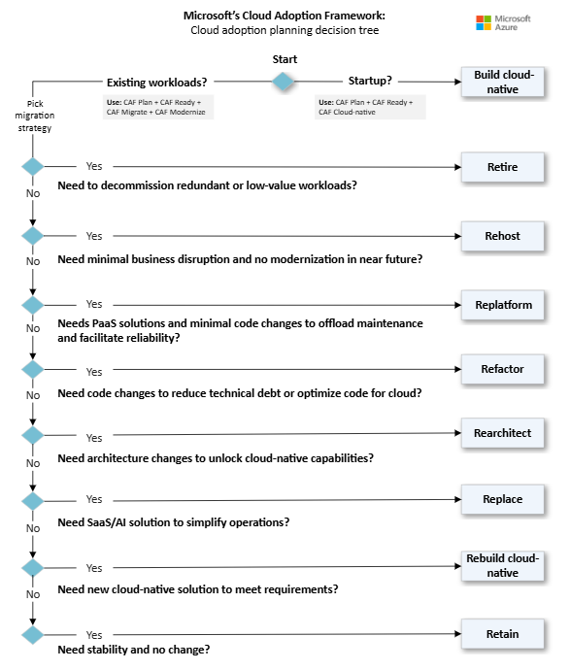
Map your cloud adoption journey
Build cloud-native. If you're a startup with no existing workloads, you build your business cloud-native from the ground up. This approach fosters rapid development using cloud-native design. You follow a portion of CAF Plan: prepare, plan, estimate, document.
Migrate existing workloads. Enterprises must evaluate their existing IT estate and determine the best migration strategy for each workload based on business drivers. You follow all of CAF Plan: prepare, plan, discovery, select, assess, estimate, document.

Slide 10
Choose a cloud operating model
Operations approach | Best for | Responsibilities | Pros | Cons
Centralized | Startups, single-cloud estates | One cloud team manages every function | Simpler control, uniform standards | One team becomes a bottleneck as scale grows
Shared Management | Mid-size or enterprise estates, hybrid, or multicloud | Platform teams build the platform landing zones, manages shared services, and governance guardrails. Workload teams work autonomously within guardrails | Balances standards with team agility | Requires clear responsibilities and strong coordination
Decentralized | Tech-savvy startups, innovation programs | Each team owns every cloud task | High speed and autonomy | Weaker standardization, higher risk of security gaps

Slide 11
Step 1 – Discover the Digital Estate
The first activity is to understand the existing IT environment (also called the digital estate).
Step 2 – Inventory the Workloads
Workload | Type | Criticality
HR Portal | Web Application | Medium
Payroll | Business Application | High
SAP | ERP | Critical
CRM | Customer Management | High
Email Server | Infrastructure | Medium
Step 3 – Assess Workloads
Is it cloud-ready?
Does it require modernization?
Is it business-critical?
What operating system does it use?
What database does it depend on?
Is it supported?

Slide 12
Step 4 – Dependency Analysis
Many applications communicate with databases, APIs, storage accounts, and other services. Example : Payroll Application depends upon SQL Database
Step 5 – Prioritize Workloads
Organizations usually migrate low-risk workloads before business-critical systems.
Step 6 – Define Migration Waves
Means which Application / database migrated in Phases like Phase-1 Phase-2
Step 7 – Estimate Timeline and Resources
Activity | Duration
Assessment | 2 Weeks
Landing Zone Preparation | 3 Weeks
Wave 1 Migration | 1 Week
Wave 2 Migration | 2 Weeks
Wave 3 Migration | 3 Weeks

Slide 13
Step 8 – Select Migration Strategy (The 7 Rs)
Cloud migration strategy | Business driver | Key indicators for this strategy
Retire | Need to decommission redundant or low-value workloads | • Workload has limited current or future business value • Migration or modernization cost outweighs business benefits
Rehost | Need minimal business disruption and no modernization in near future | • Workload is stable • Workload is compatible with Azure • Low-risk migration • Short-term cloud adoption goals • No immediate need for modernization • Reduce capital expense • Free up datacenter space • Inexperience with Azure
Replatform | Needs PaaS solutions and minimal code changes to offload maintenance and facilitate reliability | • Simplify reliability and disaster recovery • Reduce OS and licensing overhead • Improve time-to-cloud with moderate investment • Containerize app
Refactor | Need code changes to reduce technical debt or optimize code for cloud | • Decrease cost of maintenance • Reduce technical debt • Use Azure SDKs • Improve code performance • Optimize code costs • Apply cloud design patterns • Instrument code for monitoring
Rearchitect | Need architecture changes to unlock cloud-native capabilities | • Application requires modularization or service decomposition • Scaling needs vary by component • Architecture must support future innovation • Mix technology stacks
Replace | Need SaaS/AI solution to simplify operations | • Simplify operations • Internal development resources are better used elsewhere • Little need for customization
Rebuild | Need new cloud-native solution to meet requirements | • Legacy system is too outdated or inflexible • Build applications faster • Reduce operational cost • Need modern frameworks and tools
Retain | Need stability and no change | • Workload is stable, compliant, and meets business needs • No near-term driver to move • Low ROI from migration

